Slide 1
Prediction of Adult Census Income Level
Tong Wu, Yu Wu, Weizhou Wang, Xiaoyu Wang

Slide 2
Outline
Introduction
Paper reproduce
New approaches
Comparison
Conclusion

Slide 3
Introduction
Adult dataset is done by Barry Becker from the 1994 Census database.
Adult dataset contains adults’ several attributes, including work class, education, occupation, work hours per week and income salary.
Main prediction task is to determine whether a person makes over 50K a year.
Our job is to reproduce results from papers cite this database and give other approaches for prediction.
We use paper from Bekena [1] and S.deepajothi, D. s selvarajan [2] to reproduce.
We bring new approaches to the dataset: logistic regression and SVM

Slide 4
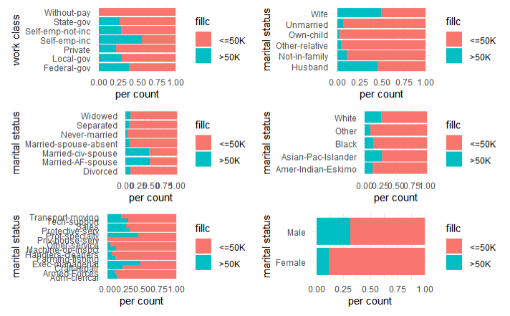
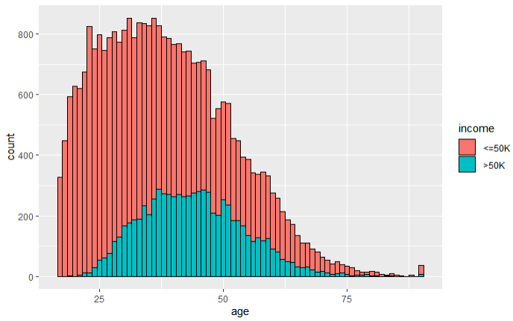
Exploratory Data Analysis (EDA)
Notes:
Before reproducing the paper, we did EDA for this dataset, the figures plot on the slide shows the distribution of number of people with different attributes. This step allows the data to be visualized and is essential for later data cleaning and validation of the results

Slide 5
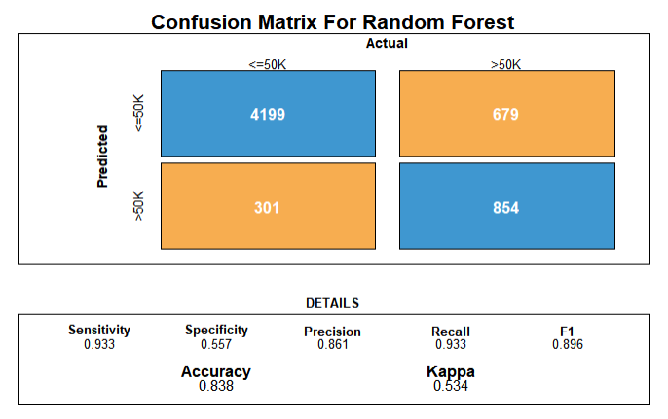
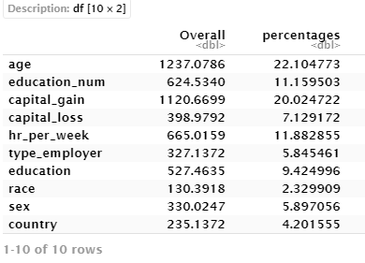
Using decision tree classifier to predict income levels [1]
Paper from Bekena, using random forest classifier to predict the income level. In the paper, importance ranking for each attribute is also given.
Notes:
These two diagram is our reproduce result. During the reproduction, some data cleaning procedure is done, including filled missing values, exclude meaningless attributes and convert the continuous variables to string. From the left-hand side graph, the random forest classifier reaches 83.8% of accuracy. And the right-hand graph shows the importance score of each attributes. The result we got is similar to paper, where the attribute age, capital gain and working hours per week are most important attributes influencing the income level.

Slide 6
A Comparative Study of Classification Techniques On Adult [2]
Paper from S.deepajothi and D. s selvarajan. Used four different algorithms, including naïve Bayesian, Zero R, K-means and Random Forest to compare the accuracy.

Slide 7
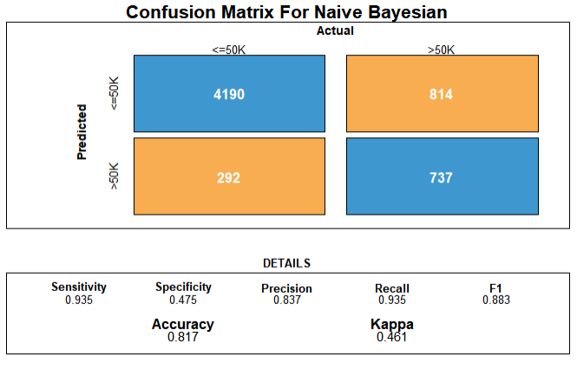
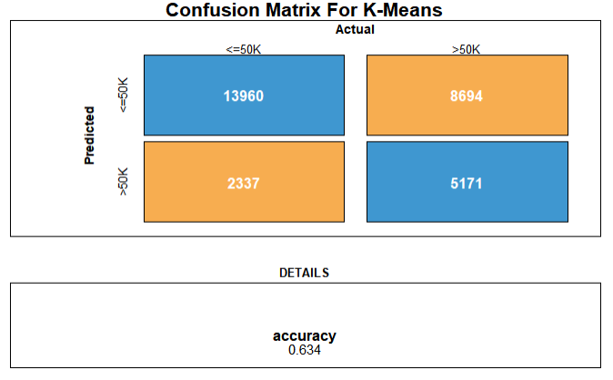
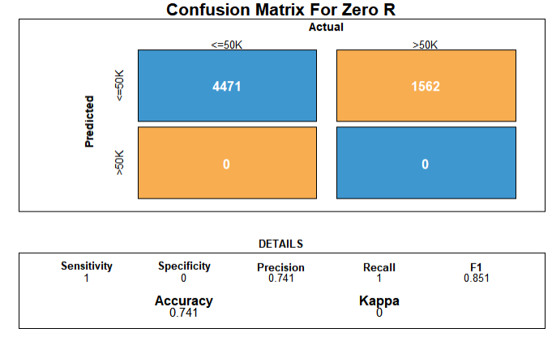
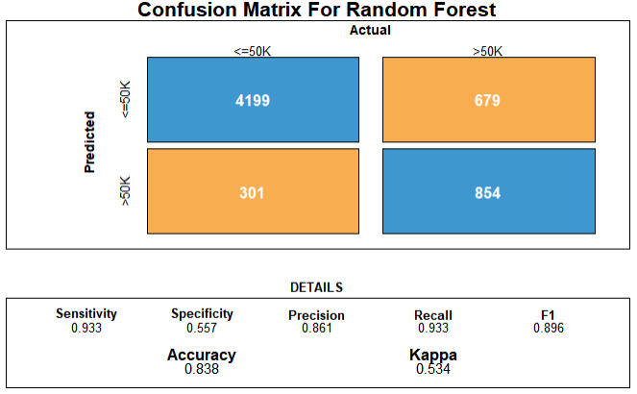
A Comparative Study of Classification Techniques On Adult [2]

Slide 8
A Comparative Study of Classification Techniques On Adult [2]
The result is similar to the paper, where Random Forest and Naive Bayesian has the relative higher accuracy than K-means and Zero R.
The result may because of the high accuracy for Naive Bayesian and Random Forest classifier when dealing with the large-scale data set.
K-means as unsupervised learning, learn from un-tagged dataset. Although dimensionality reduction was already done in the code, the high dimension still drag the accuracy.
Zero R is a naive approach to classify a dataset, which based on target and ignores other independent attributes, so it brings fast computing with relative low accuracy.

Slide 9
New Approaches
Logistic Regression use several independent variables to predict categorical dependent variables. We use Logistic Regression to build the model and predict the income level in order to see the accuracy.
The Support Vector Machine (SVM) can be used to classify the dataset into two groups, which is fit for the adult dataset. The SVM with the principle of a maximum marginal classifier, and a multi-dimensional space to classify data points since the SVM generates a hyperplane in a multi-dimensional space. We use the SVM classifier to build the model and predict the income level in order to see the accuracy of SVM.

Slide 10
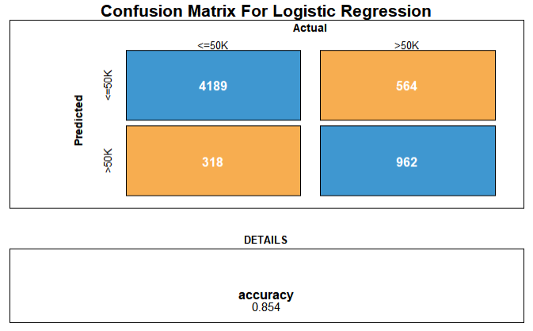
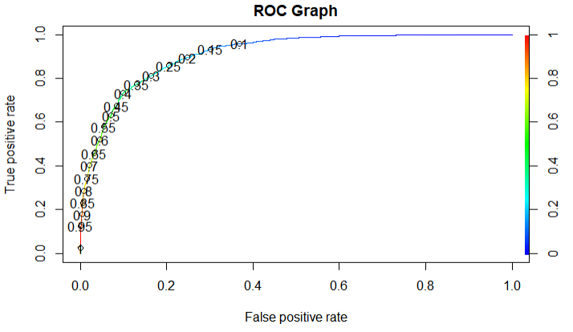
New Approaches – Logistic Regression

Slide 11
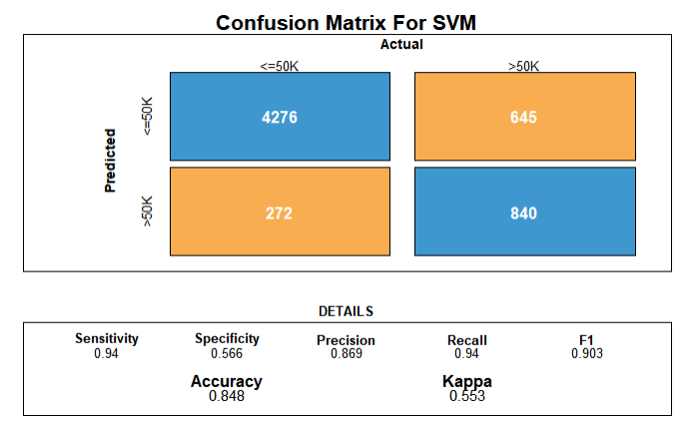
New Approaches - SVM

Slide 12
Comparison
Four algorithms from paper are given different accuracies which are similar to the result of paper.
Two new algorithms from us representing a relatively high accuracy.
Algorithm | Accuracy
Random Forest | 83.8%
Naïve Bayesian | 81.7%
K-means Clustering | 63.4%
Zero R | 74.1%
Logistic Regression | 85.4%
SVM | 84.8%

Slide 13
Conclusion
In this project, we analysis the adult dataset, did exploratory data analysis to visualise the data and did data cleaning for the future algorithm implementation.
We reproduced two papers and got similar results. The first paper introduced random forest classifier and ranked the attributes according to the importance score. The second paper compared four different classifier algorithms’ accuracy.
We also gave two different algorithms, logistic regression and SVM, both representing a relatively high accuracy.

Slide 14
References
[1] Sisay Menji Bekena:“Using decision tree classifier to predict income levels”, Munich Personal RePEc Archive 30th July, 2017
[2] S.deepajothi, D. s selvarajan. (2012). A Comparative Study of Classification Techniques On Adult Data Set. International Journal of Engineering Research, 1(8), 8.

